Slide 1

A Project/Dissertation/Seminar Report
PRESENTATION
Hotel Booking Management System
SUBMITTED BY SUPERVISED BY
Kanishk Sahijwani Mr. Tabish Mufti
2020-310-086 Assistant Professor
B.Tech In Computer Science
SUBMITTED TO
Department of Computer Science & Engineering
School of Engineering Sciences & Technology
JAMIA HAMDARD

Slide 2
INTRODUCTION
a seamless solution for guests to browse, book, and manage their accommodations effortlessly. With intuitive interfaces and secure transactions, guests can easily find their ideal room and make reservations hassle-free. For hotel staff, streamlined tools ensure efficient management of room availability and reservations, enhancing overall operational efficiency. Welcome to a world where booking accommodations is simple and stress-free.

Slide 3
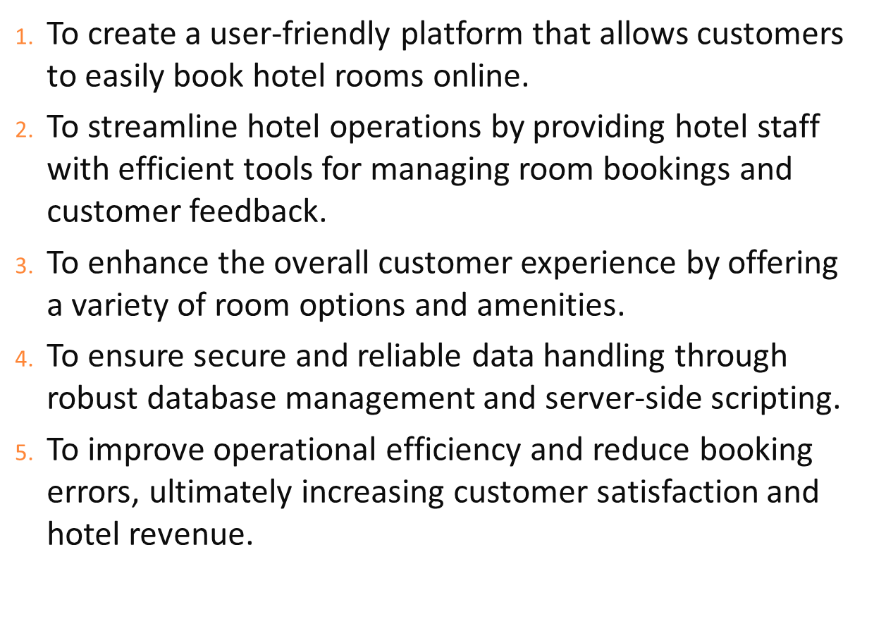
OBJECTIVES

Slide 4
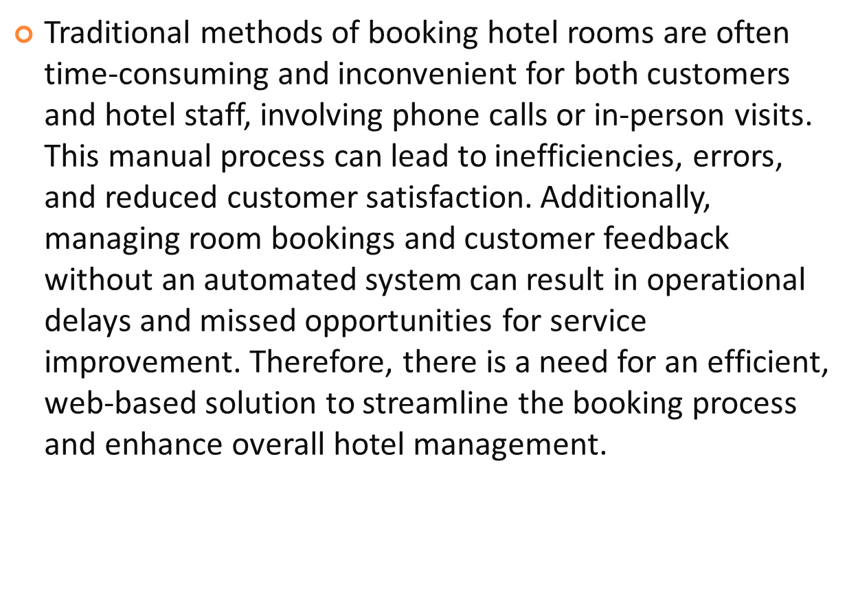
PROBLEM STATEMENT

Slide 5
LANGUAGES USED
PHP: The primary language used to develop the back-end of the system. PHP is a server-side scripting language that allows for dynamic content generation and database connectivity.
HTML/CSS: The front-end of the system is built using HTML and CSS. HTML provides the structure and content of the web pages, while CSS provides the styling and layout
JAVASCRIPT: Used for client-side scripting to add interactivity and dynamic functionality to the web pages.
MYSQL: The database management system used to store and retrieve guest information, room bookings, and other relevant data.
BOOTSTRAP: A front-end framework used to design responsive and mobile-friendly web pages. It includes pre-built CSS and JavaScript components that can be easily integrated into the system

Slide 6
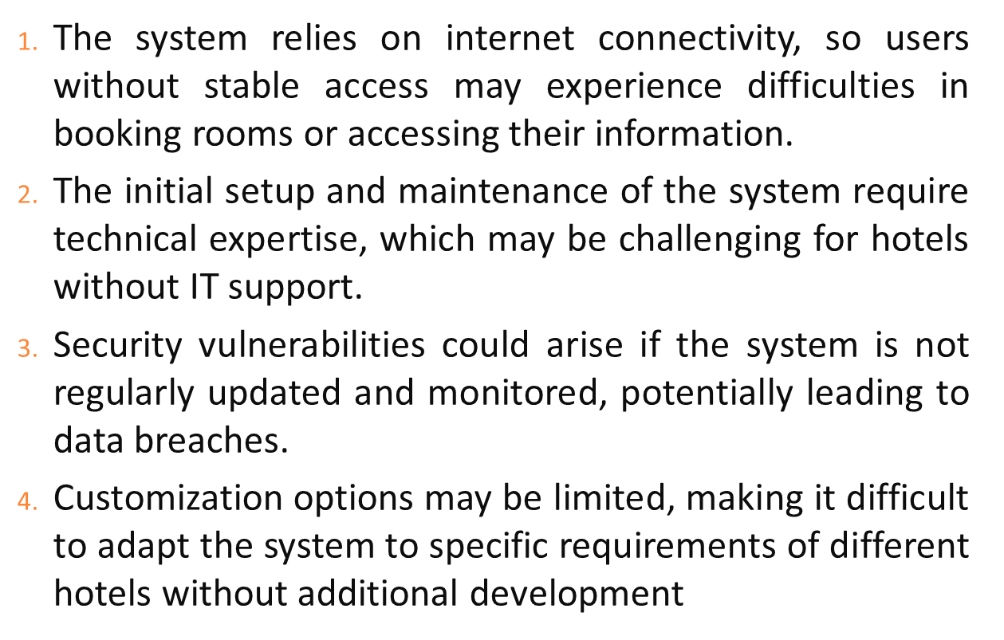
LIMITATIONS

Slide 7
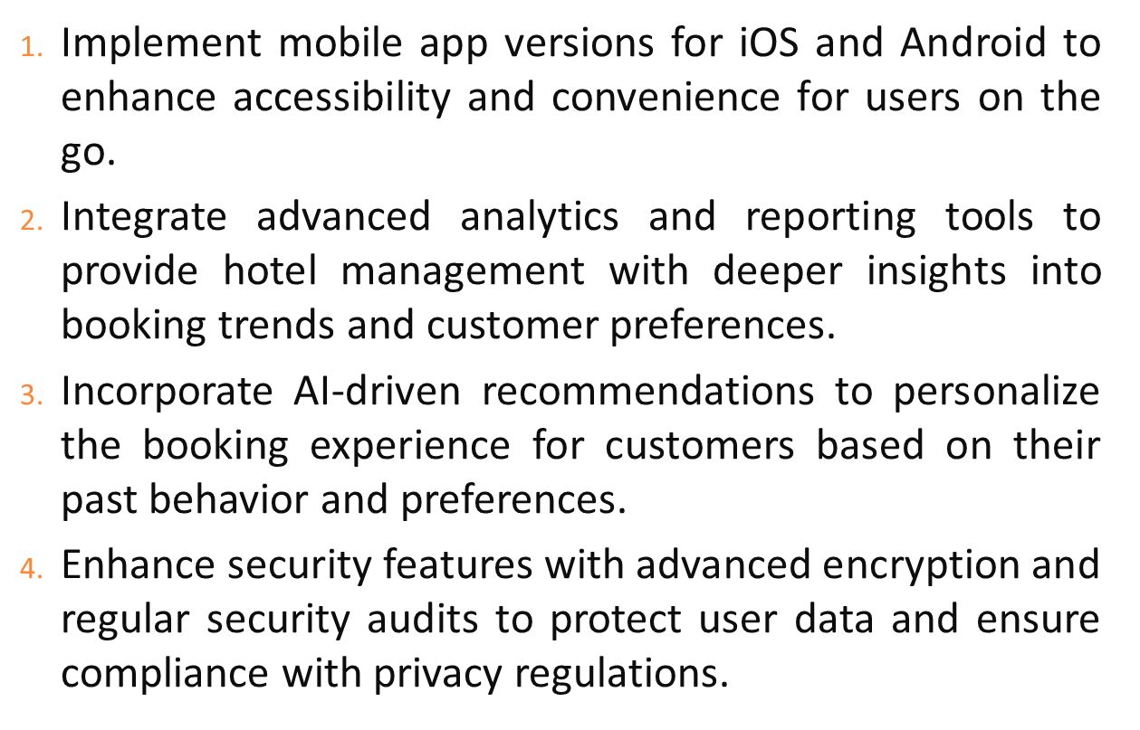
FUTURE WORK

Slide 8
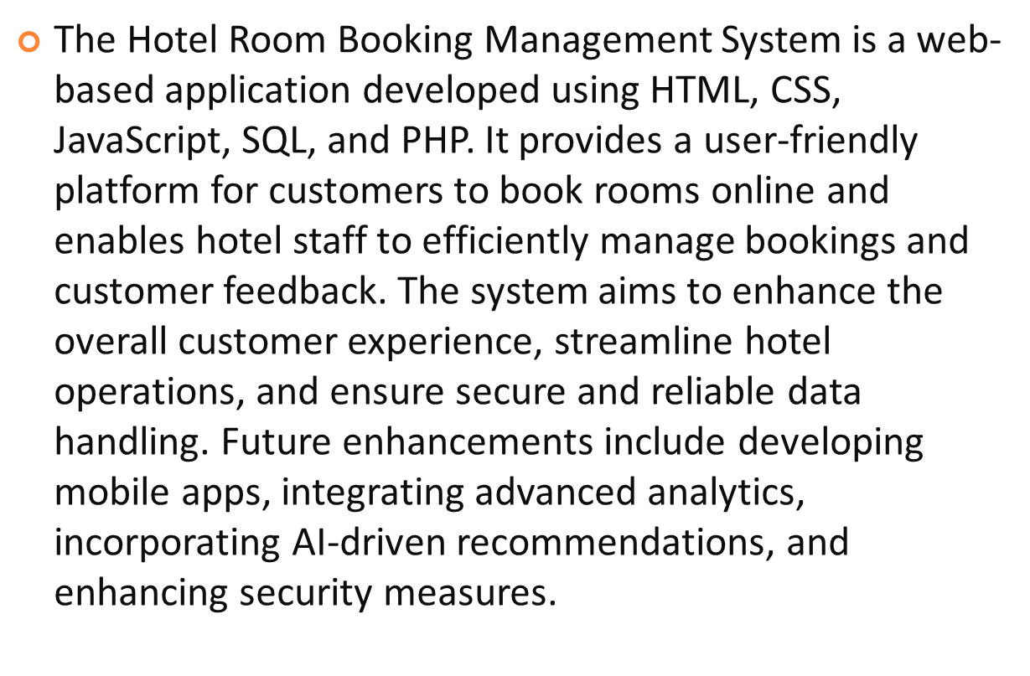
SUMMARY

